Slide 1
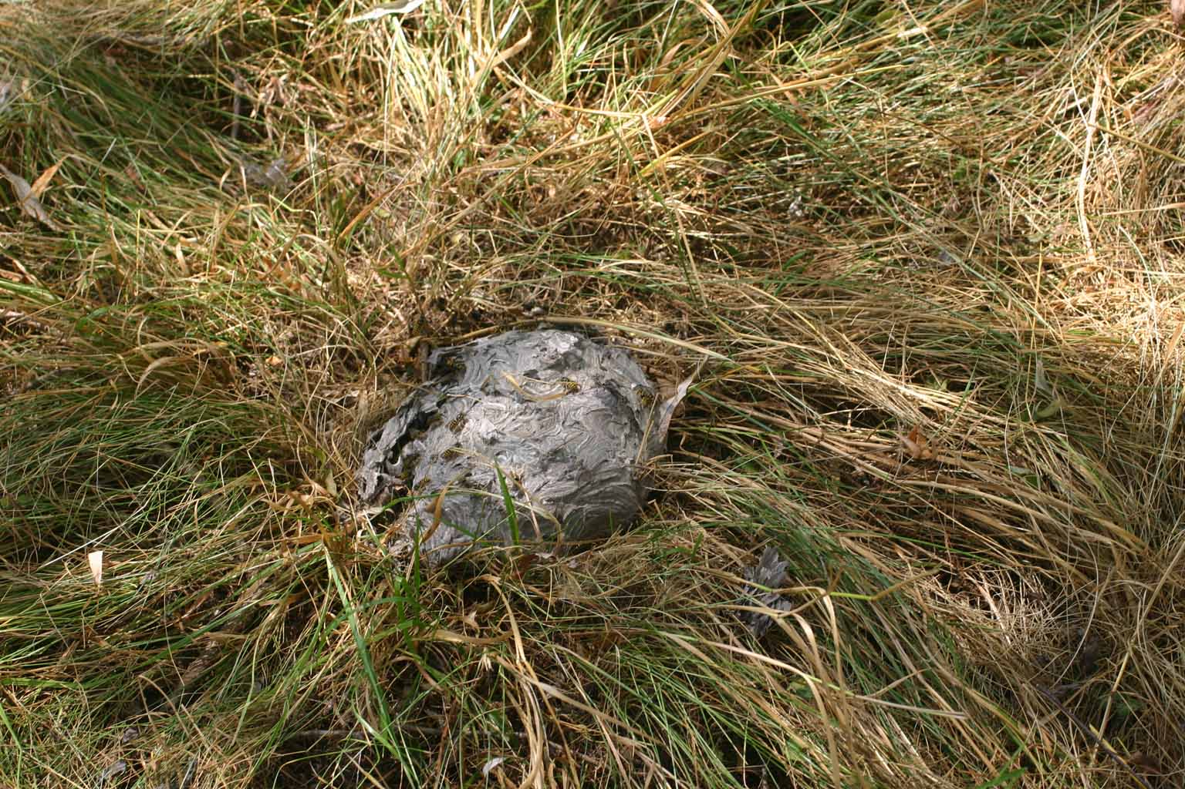
Ground Wasps Vespula vidua

Slide 2
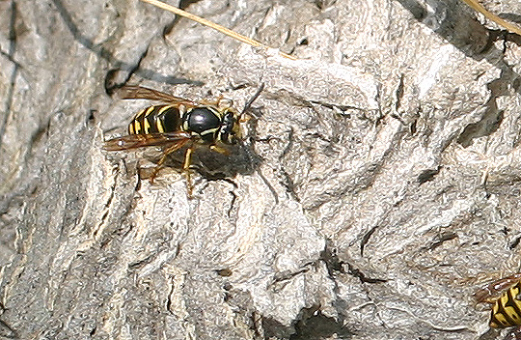
Ground Wasps Vespula vidua

Slide 3
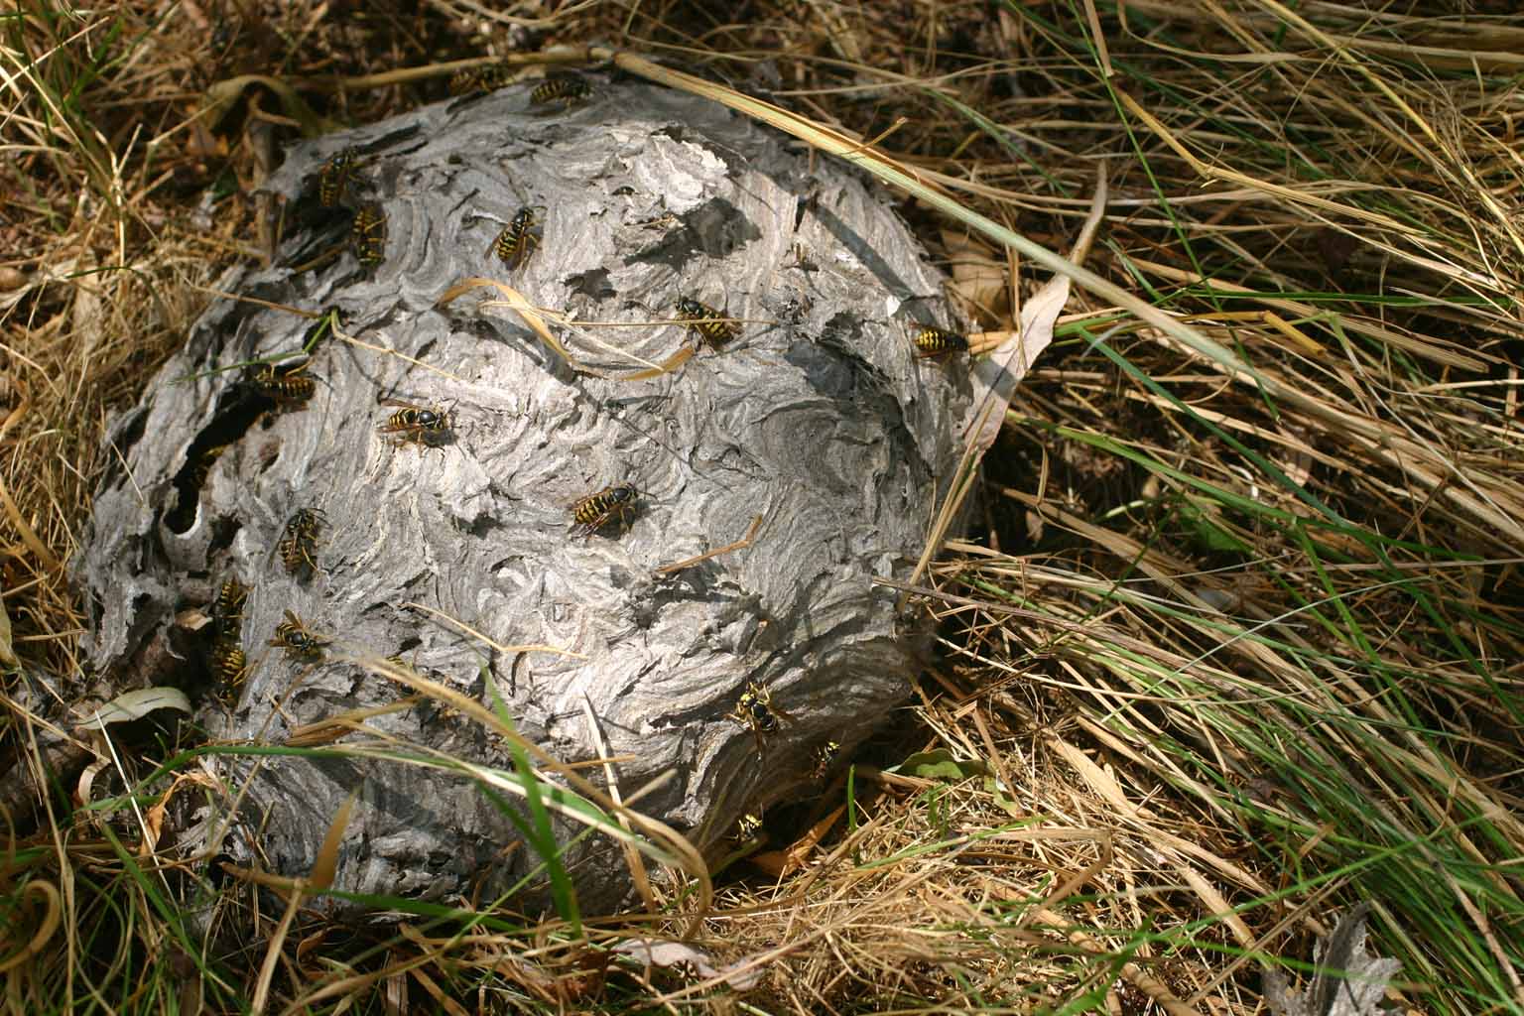
Ground Wasps Vespula vidua

Slide 4
Ground Wasps Vespula vidua

Slide 5
Ground Wasps Vespula vidua

Slide 6
Ground Wasps Vespula vidua

Slide 7
Ground Wasps Vespula vidua

Slide 8
Ground Wasps Vespula vidua

Slide 9
Ground Wasps Vespula vidua

Slide 10
Ground Wasps Vespula vidua

Slide 11
Ground Wasps Vespula vidua
Could a skunk have eaten the wasps? We do not know what ripped the nest apart.

